Slide 1
AWS KEY MANAGEMENT SERVICES
MANISHA AKKAPALLY

Slide 2
AGENDA
Introduction to AWS KMS
Use Case
Architecture Flow
AWS Services Used
Implementation Steps
Live Demo Execution
Security Benefits
Conclusion

Slide 3
What is AWS KMS ?
AWS KMS (Key Management Service) is a managed AWS service used to create and manage encryption keys for protecting sensitive data.
AWS KMS simplifies encryption management by securely integrating with multiple AWS services such as:
Amazon S3
Amazon RDS
Amazon EBS
AWS Lambda
AWS Secrets Manager

Slide 4
Key Features
Centralized Key Management : Manage all encryption keys from a single AWS service.
Data Encryption : Encrypt sensitive customer data and files securely.
IAM Integration : Control who can access and use encryption keys.
Automatic Key Rotation : AWS can automatically rotate keys for improved security.
Audit & Monitoring : Track key usage using AWS CloudTrail.
AWS Service Integration : Works seamlessly with AWS storage, database, and compute services.

Slide 5
Types of Keys in AWS KMS
AWS Managed Keys :
Created and managed automatically by AWS.
Customer Managed Keys (CMK) :
Created and controlled by customers for custom permissions and policies.
Imported Keys :
Customers can import their own encryption keys into AWS KMS.

Slide 6
Benefits of AWS KMS
Improved data security
Simplified encryption management
Regulatory compliance support
Secure access control
Reduced operational overhead

Slide 7
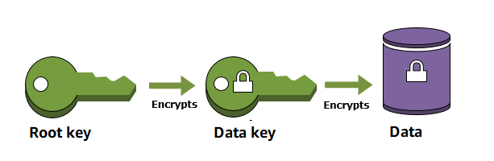
Why use AWS KMS?

Slide 8
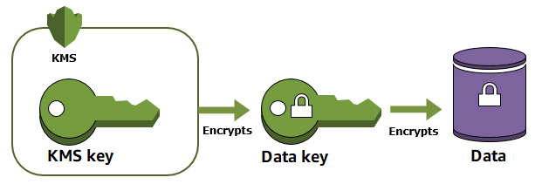
When you encrypt data, you need to protect your encryption key. If you encrypt your key, you need to protect its encryption key.
Eventually, you must protect the highest level encryption key (known as a root key) in the hierarchy that protects your data. That's where AWS KMS comes in.
AWS KMS protects your root keys. KMS keys are created, managed, used, and deleted entirely within AWS KMS. They never leave the service unencrypted. To use or manage your KMS keys, you call AWS KMS.

Slide 9
How AWS KMS Works
Use Case : AWS KMS uses envelope encryption to securely protect sensitive data.
When a user uploads a file:
AWS KMS generates a data encryption key.
The file is encrypted using the data key.
The data key itself is encrypted using the KMS master key.
Both encrypted data and encrypted data key are stored securely.
Authorized users with KMS permissions can decrypt and access the file.

Slide 10


